Slide 1

SQL Subqueries and Variables or, how to reuse results and query the results of other queries
Notes:
...
Hello everyone and welcome to our session!
In this session, we will dive deeper into one of the more advanced concepts of S-Q-L.
In particular, we will focus on subqueries and variables, which can enable very advanced data analysis to be performed on our data. Subqueries and variables allow us to reuse the results from one query and use them as part of another.
Subqueries are a powerful tool that can help us extract meaningful insights and make more informed decisions based on our data.
So, get ready to expand your SQL knowledge and learn how to use subqueries effectively in your data analysis.
Let's get started!

Slide 2
Subqueries for single-value calculation
and intro to variables

Slide 3
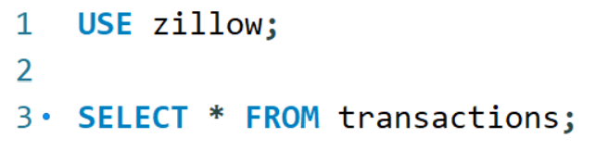
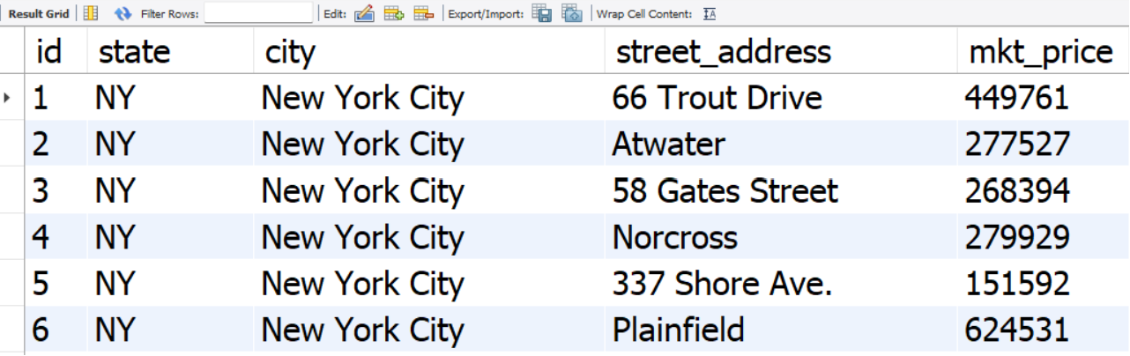
Motivating Example
Go to the Zillow database:
Singe table called “transactions,”
Five attributes: id, state, city, street address, and market price.
Tasks:
Compute the national average sale price across all houses in the database
List all cities and the average price of the houses in each city
List all cities and the average price of the houses for all cities where the average home price is above $550,122.52
List all cities and the average price of the houses for all cities where the average home price is above the national average
Notes:
Let's start with a motivating example. (Incidentally, this was an interview question at Zillow.)
For this example, we'll use a toy database called Zillow, which contains information on 100 house transactions in different cities.
It contains only one table called “transactions,” with five columns: id, state, city, street_address, and market price.
First, we want to calculate the national average price across all houses in the database.
Then, we want to calculate the average price for each city, and limit the results to cities with an average price that exceeds a threshold.
Finally, we want to identify which cities have an average price higher than the national average.

Slide 4
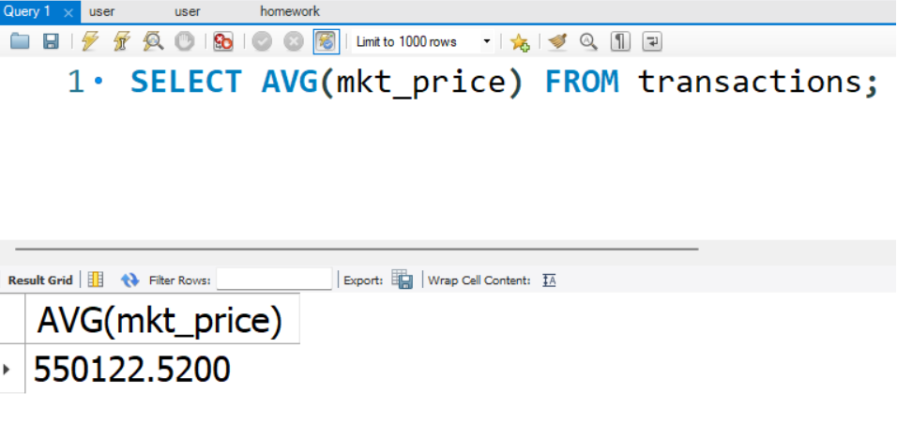
Need for Subqueries
Compute the national average sale price across all houses in the database
SELECT AVG(mkt_price) FROM transactions
Notes:
Let's write some SQL to get started.
Remember our end-goal: Identify which cities have an average price higher than the national average price.
We'll use a simple aggregation query to calculate the national average market price first:
SELECT
<break time="0.5s" />
average (market_price)
<break time="0.5s" />
FROM transactions;
The result is 550 thousand 122 dollars and 52 cents.

Slide 5
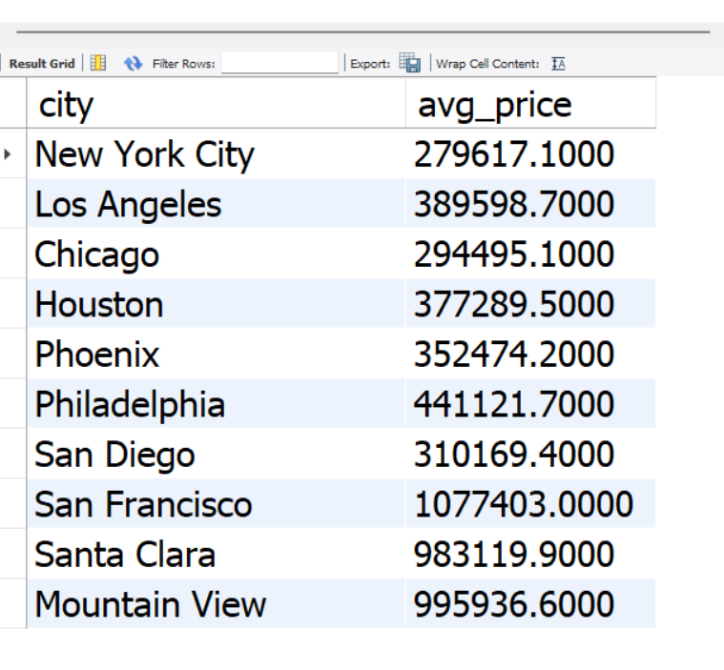
Need for Subqueries
Compute the national average sale price across all houses in the database
SELECT AVG(mkt_price) FROM transactions
List all cities and the average price of the houses in each city
SELECT city, AVG(mkt_price) AS avg_price
FROM transactions
GROUP BY city
Notes:
Next! <break time="0.25s" />
We want to calculate the average market price for each city.
We'll use a simple aggregation "GROUP BY" query to break down the results by city.
So, we take the existing query:
SELECT
average (market_price)
FROM transactions;
Then, we add a GROUP BY clause, to break down the calculation of the averages.
SELECT
<break time="0.5s" /> city,
Average (market_price) AS Average_price
FROM transactions
<break time="0.5s" />
GROUP BY city;
The result shows us the average price for each of the ten cities in the database.

Slide 6
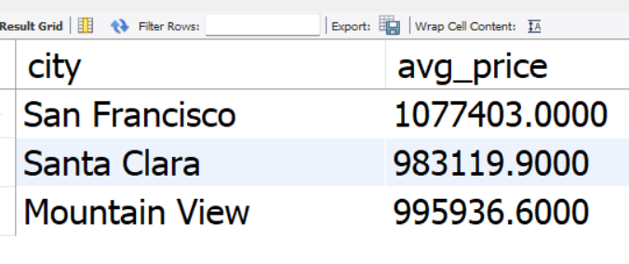
Need for Subqueries
Compute the national average sale price across all houses in the database
SELECT AVG(mkt_price) FROM transactions
List all cities and the average price of the houses in each city
SELECT city, AVG(mkt_price) AS avg_price
FROM transactions
GROUP BY city
List all cities and the average price of the houses for all cities where the average home price is above $550,122.52
SELECT city, AVG(mkt_price) AS avg_price
FROM transactions
GROUP BY city HAVING avg_price > 550,122.52
Notes:
Now that we have the average price for each city, we want to identify which cities have an average price higher than the national average.
Remember, from our first query, we know that the national average price is $550,122.52
So, we'll use a "HAVING" clause to filter the results and identify the three cities that meet this criterion:
SELECT
City, Average (market_price) AS Average_price
FROM transactions
GROUP BY city;
And we add the HAVING clause:
HAVING Average_price greater than 550 thousand 122 dollars and 52 cents.
So, the three cities that have a city-wide average price higher than the national average price are:
San Francisco,
Santa Clara, and
Mountain View.

Slide 7
Need for Subqueries
Compute the national average sale price across all houses in the database
SELECT AVG(mkt_price) FROM transactions
List all cities and the average price of the houses in each city
SELECT city, AVG(mkt_price) AS avg_price
FROM transactions
GROUP BY city
List all cities and the average price of the houses for all cities where the average home price is above $550,122.52
SELECT city, AVG(mkt_price) AS avg_price
FROM transactions
GROUP BY city HAVING avg_price > 550,122.52
List all cities and the average price of the houses for all cities where the average home price is above the national average

Slide 8
Need for Subqueries
Compute the national average sale price across all houses in the database
SELECT AVG(mkt_price) FROM transactions
List all cities and the average price of the houses for all cities where the average home price is above $550,122.52
SELECT city, AVG(mkt_price) AS avg_price
FROM transactions
GROUP BY city HAVING AVG(mkt_price) > 550122.52
List all cities and the average price of the houses for all cities where the average home price is above the national average
SELECT city, AVG(mkt_price) AS avg_price
FROM transactions
GROUP BY city HAVING AVG(mkt_price) > (SELECT AVG(mkt_price) FROM transactions)
Notes:
So, the approach of computing first the national average price and then pasting the value in the query that calculates city averages works.
However, it requires copying and pasting the national average price from one query to another, which is not only error-prone but also makes our queries static: We need to update the average national price every time it changes.
To avoid this issue, we can directly use the first query, which calculates the national average, as part of a larger query.
<break time="0.5s" />
How to achieve that?
We take the query that calculates the national average, put it in parentheses, and then we can reuse the outcome as part of a larger query.
So we get:
SELECT
City, Average (market_price) AS Average_price
FROM transactions
GROUP BY city
HAVING Average_price greater than
And now, instead of having the numeric value, we write instead
Parenthesis
SELECT AVG(market_price) FROM transactions
Close parenthesis
<break time="0.5s" />
That's it!
Now, the new query works without copy-pasting and will always be up to date.
And that's the main advantage of subqueries in SQL.
We can compose complex queries by building on the results of previous queries.
Building step-by-step, you easily write queries that would have been hard or impossible without subqueries.
Next, let’s examine one small trick to make our query even more readable.

Slide 9
Alternative with Variables
Query starts becoming harder to read
SELECT city, AVG(mkt_price) AS avg_price
FROM transactions
GROUP BY city HAVING AVG(mkt_price) > (SELECT AVG(mkt_price) FROM transactions)
Compute the national average sale price across all houses in the database
SET @national_average = (SELECT AVG(mkt_price) FROM transactions)
List all cities and the average price of the houses for all cities where the average home price is above $550,122.52
SELECT city, AVG(mkt_price) AS avg_price
FROM transactions
GROUP BY city HAVING AVG(mkt_price) > @national_average
Notes:
If you look at the query we just wrote, it becomes harder to read.
For example, we need to understand what the subquery
(select average(price) from Transactions)
calculates, to understand what the inequality in the HAVING clause is filtering for.
<break time="0.5s" />
So, what can we do?
<break time="0.5s" />
Instead of writing increasingly complex queries, we break down the calculation into components.
In this case, instead of having an “inlined subquery” to calculate the national average, we can use variables and store the outcome of the query in a variable.
In our case, we would write something like:
SET
and then we write
@national_average = (select average(price) from Transactions);
This SET statement creates a variable called @national_average that stores the value $550122.52, the query output.
Next, we can rewrite our query as follows:
SELECT city, Average (market_price) AS average_price
FROM transactions
GROUP BY city
HAVING average_price greater than national_average
<break time="0.5s" />
This, makes our query more readable than the initial query with the “inlined” subquery.
In general, using variables can improve the clarity of your code by giving meaningful names to intermediate results.
<break time="2s" />
I hope you see how subqueries can allow us to write more complex queries by creating and storing intermediate results.
<break time="1s" />
Next, ... we will continue with more examples of subqueries.
<break time="1s" />
Until then… Play around, and, practice!
See you next time!

Slide 10
Subqueries for semijoins and antijoins

Slide 11
Subqueries for SemiJoins and AntiJoins WHERE + IN
The “IN” clause allows us to check if an attribute appears within a list returned by another SQL query
SELECT A, B, C,…
FROM X
WHERE A IN (SELECT attr FROM ….)

Slide 12
WHERE …. IN …. practice
Semijoin: Using a WHERE…IN subquery, find the Drama movies.
Your subquery should return the IDs of Drama movies
Try also the same query with a JOIN
Antijoin: Using a WHERE… NOT IN subquery, remove the Drama movies.
Use the NOT IN construct now
Notice that the JOIN query does not work for movies that have “Drama” and other genres associated with them

Slide 13
Semijoins using subqueries (WHERE…IN)
Semijoin: Return all the details from the movies table for Drama movies.
Using subquery in the WHERE clause:
SELECT *
FROM movies
WHERE id IN (
SELECT movie_id
FROM movies_genres
WHERE genre='Drama’
)
Using a join:
SELECT M.*
FROM movies M
JOIN movies_genres G ON M.id = G.movie_id
WHERE G.genre = 'Drama'

Slide 14
Anti-joins using subqueries (WHERE…IN)
Anti-join: Return all the movie details excluding all Drama movies
Using subquery in the WHERE clause:
SELECT *
FROM movies
WHERE id NOT IN (
SELECT movie_id
FROM movies_genres
WHERE genre='Drama’
)
It is much harder and less readable to the same with joins.

Slide 15
Anti-join woes with outer joins
Anti-join: Return all the movie details excluding all Drama movies
SELECT M.*
FROM movies M
JOIN movies_genres G ON M.id = G.movie_id
WHERE G.genre <> 'Drama’
The query above does not work (why?)… OK, let’s do an outer join.
SELECT M.*
FROM movies M
LEFT JOIN movies_genres G ON M.id = G.movie_id
WHERE G.genre = 'Drama’ AND G.movie_id IS NULL
Does not work as well. Here is the variation that works (why?):
SELECT M.*
FROM movies M
LEFT JOIN movies_genres G ON M.id = G.movie_id AND G.genre = 'Drama’
WHERE G.movie_id IS NULL

Slide 16
WHERE …. IN …. practice
Use a WHERE…IN subquery to find the favorite bands for students who like Radiohead.
Your subquery should return the IDs of students that like Radiohead
Find the movies where Brad Pitt and George Clooney played.
Use the movies_all temporary table that we defined before to find movie ids for Brad Pitt and George Clooney
Use the SELECT * FROM movies WHERE id IN (…) AND id IN (…) construct
Use the movie ids for Brad Pitt as a subquery, and the movie ids by George Clooney as another subquery

Slide 17
Subqueries with derived tables

Slide 18
Subqueries / FROM
SELECT A, B, C, …
FROM X JOIN Y …,
WHERE …
Tables
A table can be directly replaced by another query, placed within parentheses. For readability, better to define a VIEW or TEMPORARY TABLE and use that.
SELECT A, B, C, …
FROM X JOIN (SELECT * FROM… ) Y,.. WHERE …
Tables (or queries)

Slide 19
Need for queries on top of other queries
Write a query that returns how many airports are served by one carrier, how many airports are served by two carriers, and so on SELECT carriers, COUNT(DISTINCT origin) AS airports FROM ( SELECT origin, COUNT(DISTINCT carrier) AS carriers
FROM m_ticket_prices
GROUP BY origin ) A GROUP BY carriers

Slide 20
Need for queries on top of other queries
Write a query that returns how many airports are served by one carrier, how many airports are served by two carriers, and so on SELECT carriers, COUNT(DISTINCT origin) AS airports FROM ( SELECT origin, COUNT(DISTINCT carrier) AS carriers
FROM m_ticket_prices
GROUP BY origin ) A GROUP BY carriers

Slide 21
Saving Queries: CREATE TEMPORARY TABLE
We can save the results of a query in order to reuse the results easier, using the “CREATE TEMPORARY TABLE” command.
Example:
CREATE TEMPORARY TABLE num_carriers_per_airport AS
SELECT origin, COUNT(DISTINCT carrier) AS carriers
FROM m_ticket_prices
GROUP BY origin
Then we can write
SELECT * FROM num_carriers_per_airport to access the results of the query. And then we can write our aggregate on top SELECT carriers, COUNT(DISTINCT origin) AS airports FROM num_carriers_per_airport GROUP BY carriers

Slide 22
Reusing Queries: WITH
Instead of creating a temporary table, we can also use the “WITH” statement
WITH num_carriers_per_airport AS (
SELECT origin, COUNT(DISTINCT carrier) AS carriers
FROM m_ticket_prices
GROUP BY origin
)
SELECT carriers, COUNT(DISTINCT origin) AS airports FROM num_carriers_per_airport GROUP BY carriers;

Slide 23
CREATE TEMPORARY TABLE
CREATE VIEW
CREATE TABLE WITH (aka CTE – Common Table Expressions)
CREATE TEMPORARY TABLE num_carriers_per_airport AS… Creates a temporary table with the results of the query. Table is only visible within the session (until the user disconnects). Contents do not update if the underlying tables change.
WITH num_carriers_per_airport AS… The WITH keyword allows the definition of a table name for a query, so that it can be reused later in the same SQL statement. Also known as “Common Table Expression”, it a very common way of writing queries with subqueries. Does not store the results of the subquery.
CREATE TABLE num_carriers_per_airport AS… This command creates a permanent table with the results of the query. It is visible to all users. Contents do not update if the underlying tables change.
CREATE VIEW num_carriers_per_airport AS… A VIEW is similar to a TEMPORARY TABLE, but it is visible to everyone, it does not disappear. A view does not actually store the results, and the results are updated when the underlying table change. (There the concept of “materialized view” which stores the results and updates automatically, but not supported by MySQL.)

Slide 24
Comparisons of common “subquery” approaches
 | CREATE TABLE AS… | CREATE VIEW AS … | CREATE TEMPORARY TABLE AS … | Common Table Expressions / WITH
Needs write access to database | Yes. Typically restricted to admins. | Yes. Typically restricted to admins. | No. Typically all users can use them. | No special access needed. All users can use WITH.
Lifetime | Table exists until deleted | View exists until deleted | Table exists until the user session ends | Only for the query that includes the WITH clause
Visibility | All users | All users | User only | User only
Stores data | Yes | No (unless it is a “materialized” view or “live table”) | Yes | No
Results update when underlying data change | No | Yes | No | Yes
Use case | Common when transforming data for “higher level usage” (e.g. raw to cleaned up). | To simplify common queries performed on live data. | Mainly during exploratory phase, allows storing of intermediate data for faster access. | When we want all components of a query in one clause. Common for dashboards.

Slide 25
Use case: Simplifying Common Queries
We can save the results of a query in order to reuse the results easier, using the “CREATE TEMPORARY TABLE” command.
Example:
CREATE TEMPORARY TABLE movies_all AS
SELECT R.*,
M.name AS title, M.year, M. rating,
A.first_name, A.last_name, A.gender
FROM roles R
JOIN actors A ON A.id = R.actor_id
JOIN movies M ON M.id = R.movie_id
Then we can write
SELECT * FROM movies_all to access the results of the query

Slide 26
Building on top of “saved” queries
CREATE TEMPORARY TABLE actor_stats AS
SELECT actor_id,
ROUND(AVG(rating),2) AS rating,
COUNT(*) AS num_movies,
COUNT(rating) AS rated_movies
FROM movies_all
GROUP BY actor_id
Practice: Using the table above, find “great actors”. A “great actor” has a an average rating of 6.5 and above, and starred in at least 40 rated movies.

Slide 27
Further Practice
Longer example:
Find the movies with at least 5 “great actors”.
A “great actor” has an average rating of 6.5 and above and starred in at least 40 rated movies.
Hints:
Write a query that retrieves the “great actors” (there are 221 of them) and return their actor ids.
Then write a query on roles, limiting your query to only include actors with ids in the list of “great actors” ids.
Use GROUP BY to count the number of “great actors” for each movie and use HAVING to limit the results

Slide 28
Longer Activities

Slide 29
Activity: Music Recommendations
We want to recommend music in the following style:
“People that like X also like Y”
Questions to consider
We can figure out who are the people that like certain music X. Then, we find the most popular music among these people. Would that be enough?

Slide 30
Activity: Music Recommendations
Music that is popular among fans of a certain band
# Set the band that we are analyzing
SET @band = 'Bon Jovi’;
SELECT Music,
COUNT(DISTINCT ProfileID) AS cnt
FROM FavoriteMusic
WHERE ProfileID IN (
SELECT ProfileID
FROM FavoriteMusic
WHERE Music = @band
)
GROUP BY Music
ORDER BY perc DESC;

Slide 31
Activity: Music Recommendations
Our recommendations are a bit trivial. We mainly recommend bands that are also popular in the overall population.
We need to recommend songs that are more popular among the band fans compared to the popularity in the overall population.
How do we measure the “more popular”?

Slide 32
Activity: Music Recommendations
How do we measure “more popular”?
# Store the number of people that have liked (any) music
SET @allmusicfans =
(SELECT COUNT(DISTINCT ProfileID) FROM FavoriteMusic);
CREATE TEMPORARY TABLE MusicPreferences AS
SELECT Music,
COUNT(DISTINCT ProfileID) AS cnt,
COUNT(DISTINCT ProfileID)/@allmusicfans AS perc,
FROM FavoriteMusic
GROUP BY Music
ORDER BY perc DESC;

Slide 33
Activity: Music Recommendations
Next steps
Compare the percentage numbers for each music.
We typically take the ratio of the percentages (~ probabilities) between percentage in the focal population (band fans) and overall population.
The ratio is called “lift”

Slide 34
Activity: Books and Political Views
Compare the favorite books of liberal and conservative students. Find books that liberals like much more often than conservatives, and vice versa.
Hints
Subquery 1: List of books and likes from liberal students
Subquery 2: List of books and likes from conservative students
Join the two on book name and compare
Questions to consider
How to deal with the fact that we have many more liberals than conservatives?
Should we avoid noisy results by only keeping books with a certain number of likes overall?
What type of join should we use for our comparison of liberals and conservatives? INNER or OUTER? What is the difference?

Slide 35
Activity: Books and Political Views
Analytics Concept: Lift
Lift has many definitions, but most often is defined as a ratio of rates (aka probabilities)
lift = (rate in target group) / (rate in control group)
In our scenario target = liberals, control = conservatives (or vv)
Analytics Concepts: Log-odds
Ratios (like lift) go from 0 to infinity, with 1 being the neutral
Ratios are not additive (sum of ratios is meaningless)
Ratios are “multiplicative”
Hard to visualize lifts below 1
We often take the log of ratios (aka log-odds).
Log-odds are symmetric around 0, and they are additive

Slide 36
Activity: Books and Political Views
By having the “log-odds” for each book, we can now score individuals
Save the query that calculates the log-odds for each book
If we sum the “log-odds” scores of the “book likes” for each ProfileID, we get a “log-odds” score for each ProfileID
Write the query that calculates the score for each ProfileID using the results of the query that calculates log-odds per book
A positive sum indicates positive correlation with the target group and vice versa.

Slide 37
Activity: Books and Political Views
Evaluating the scores:
Check how often we classify liberals and conservatives correctly (note that we used the data already to calculate the book scores)
Check if we classify “very liberal” and “very conservative” correctly (or keep a certain set of the population out of book score calculations and use it for testing)
Using the scores (“inference”):
We can now make inferences about all ProfileIDs, even if they do not list their Political Views

Slide 38
Practice: Books and Gender
Analyze Book preferences by gender. What are the books that men like and what are the books that women like? Show the lifts and log-odds.

Slide 39
Appendix: Variables

Slide 40
Variables
Variables in SQL allow us to store values in generic names and reuse the generic names instead of the literal values
Sometimes we want to make our queries generic, and have placeholders
SET @band = ‘Radiohead’
Other times we want to store the (single value) result of a query in a variable to use later.
Number of liberal students
SET @liberal = (SELECT COUNT(*) FROM Profiles WHERE PoliticalViews=‘Liberal’)
Variables are especially useful when we execute a sequence of SQL statements and we want to reuse results from previous queries.

Slide 41
Subqueries, Variables, and so on
Find the Music that people that like Radiohead tend to like.
Repeat the query above for Jay Z
Make your query generic, by using a @band variable and then set it appropriately:
SET @band = ‘Radiohead’
vs
SET @band = ‘Jay Z’

